Slide 1
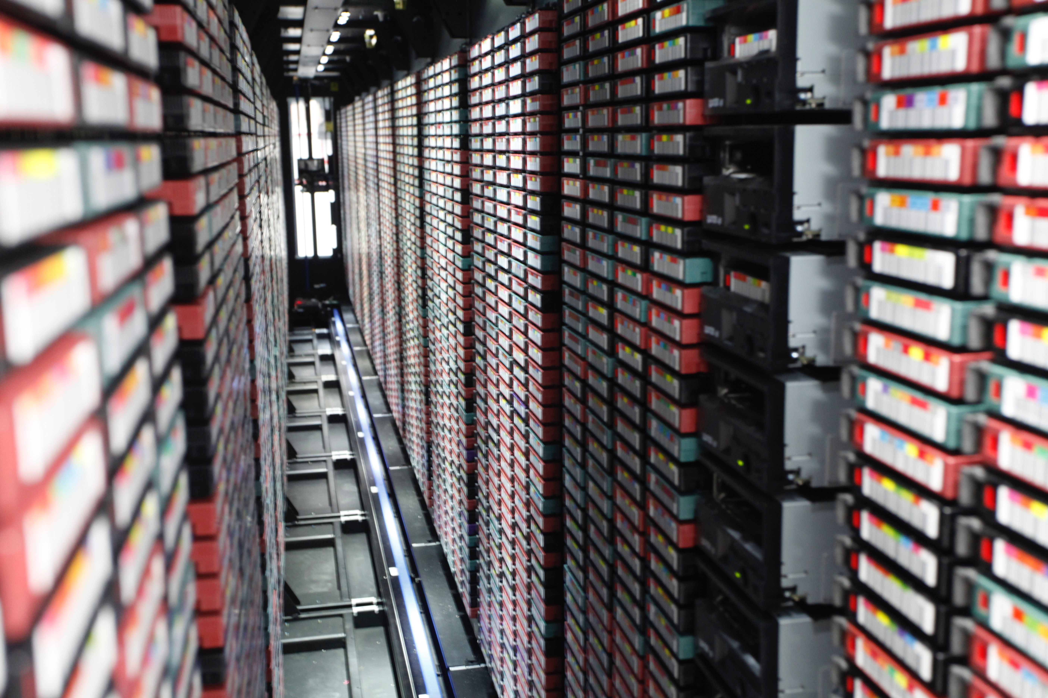
Jefferson Lab IT Division – Introduction to Computing
IT Division Groups
Computer Accounts
Email
Supported Operating Systems
File Systems Shares
Network (Wired & Wireless)
Telecommunications
Security
Scientific Computing
Physics Specific Software
Christopher Williamson
Cyber Security Analyst

Slide 2
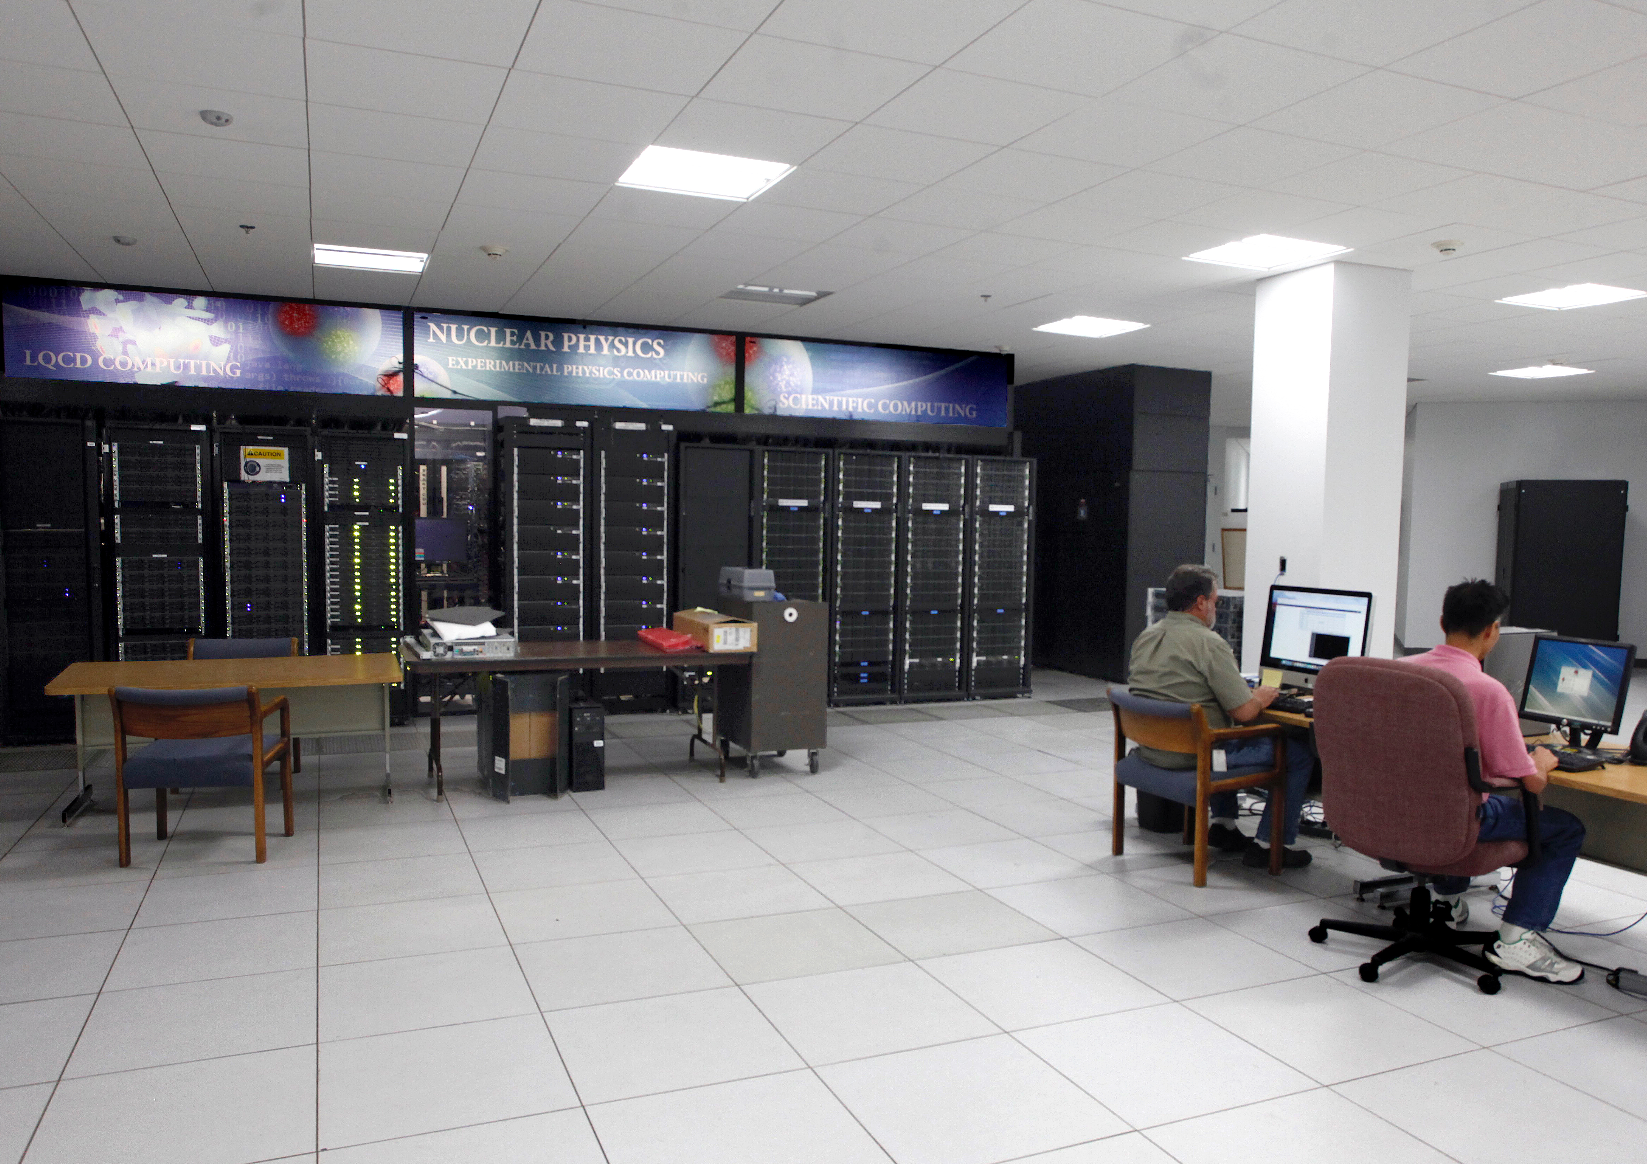
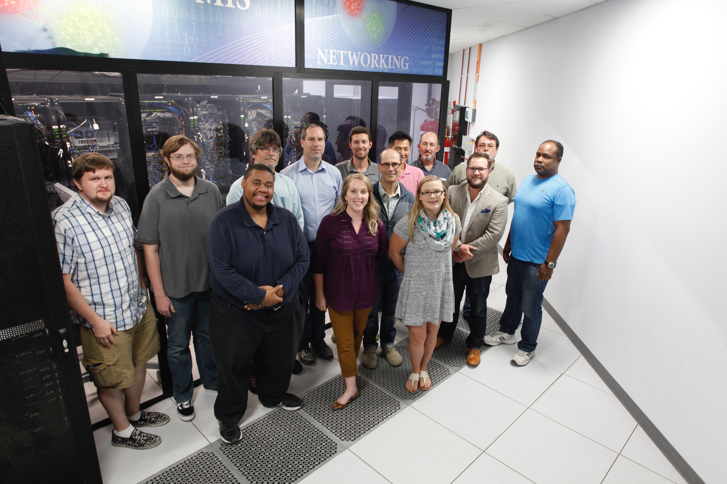
IT Division Groups
CIO – Dr. Amber Boehnlein
Computing and Networking Infrastructure (CNI)
User Services/Help Desk
Systems Team
Cyber Security
Networking and Telecommunications
Management of Information Systems (MIS)
Business Information Systems and Applications
Information Resources
Library
Publications
Records Management
Archives
Scientific Computing
Experimental Physics Analysis and Simulation
Lattice QCD Computing

Slide 3
Computer Accounts
Common User Environment (CUE)
Username
8 character maximum
No numbers; only alpha
Some compilation of your name
Password
8 character minimum
1 UPPER CASE
1 lower case
1 number
1 special character
Not allowed
Parts of your usernames
Common Name
Identifiable words
Never share your password!

Slide 4
Accounts Continued…
Central Authentication
NIS (Unix/Linux)
Active Directory
(AD, jlab.org and cniads.jlab.org
Lightweight Directory Services (LDS)
Where can I use my CUE account?
Linux, Windows, OS X computers
JLab websites
MIS Applications
Wikis
Web servers or Drupal sites
Public machines
Email (webmail.jlab.org), IMAP, SMTP
eduroam (WiFi)
Virtual Desktop Infrastructure (VDI)
JLab Terminal Server (JLABTS)
Remote access

Slide 5

Email
To Who?
username@jlab.org
First.Lastname@jlab.org
Email Clients
SquirrelMail – webmail.jlab.org
Thunderbird
Mac Mail
Pine
Mail Forward
Log into cc.jlab.org
Click on Mail Forward under WEB UTILITIES
Email Instructions:
https://cc.jlab.org/email
O365 – email & calendar
JLab employees
Some Users
A few Contractors
Miscellanous
Proofpoint for spam and phishing protection
Size Limitations – do not attach files bigger than 20MB

Slide 6



Supported Operating Systems (OS)
What does supported mean?
JLab-owned systems
Windows 10
RedHat Enterprise Linux (RHEL) 8, 7, and 6
Macintosh, OS X 10.14 & 10.15 (Mojave & Catalina)
What about other OS or non JLab-owned systems?

Slide 7

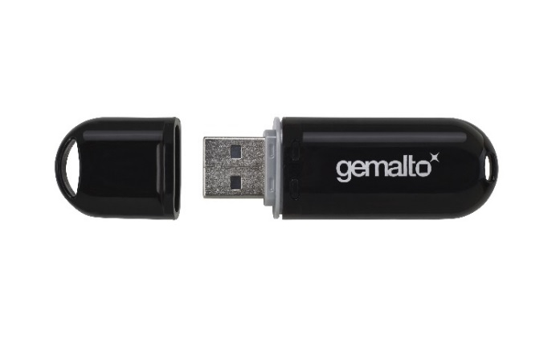
File System Shares (Network File Systems – NFS)
Home
/home/username, J: drive, //jlabhome
Personal space with 2GB default
Group
/group, O: drive, //jlabgrp (Open Science)
/sgroup, M: drive, //jlabsgrp (Management & Operations, M&O)
Multi-factor Authentication (MFA) Required
Controlled by group membership
Request access by emailing helpdesk@jlab.org
Site
/site, K: drive, //jlabsite
Access open to all JLab users
Contains cross platform utilities

Slide 8

Network File Systems (NFS) Continued…
Apps
Operating System (OS) specific repository
You can run apps directly from here
Windows installable apps
\\jlabwin\SW_Dist\User Apps
Scratch
Temporary storage area
/scratch/username, \\jlabscr\scratch, //jlabscr/scratch/username
User Web
Must apply for userweb space with Sponsor approval
2GB web area that’s public by default
Linux – /userweb/username/public_html
Windows:
\\jlabwin\userweb\username\public_html
Macintosh smb://jlabwin.jlab.org/userweb/username/public_html
https://userweb.jlab.org/username

Slide 9


Networking
Registration: Visit the IT Division Help Desk or Reggie – https://reggie.jlab.org
Wired
Virtual Local Area Networks (VLANs)
Networks – Guests vs. JLab-managed
Wireless
SSID
jlab – username & password
jlab_guest – no username & password
eduroam – academic account
Secure vs. Guest
JLab-owned machine – jlab
Non JLab-owned machine – jlab or jlab_guest (both will give you a guest IP)

Slide 10
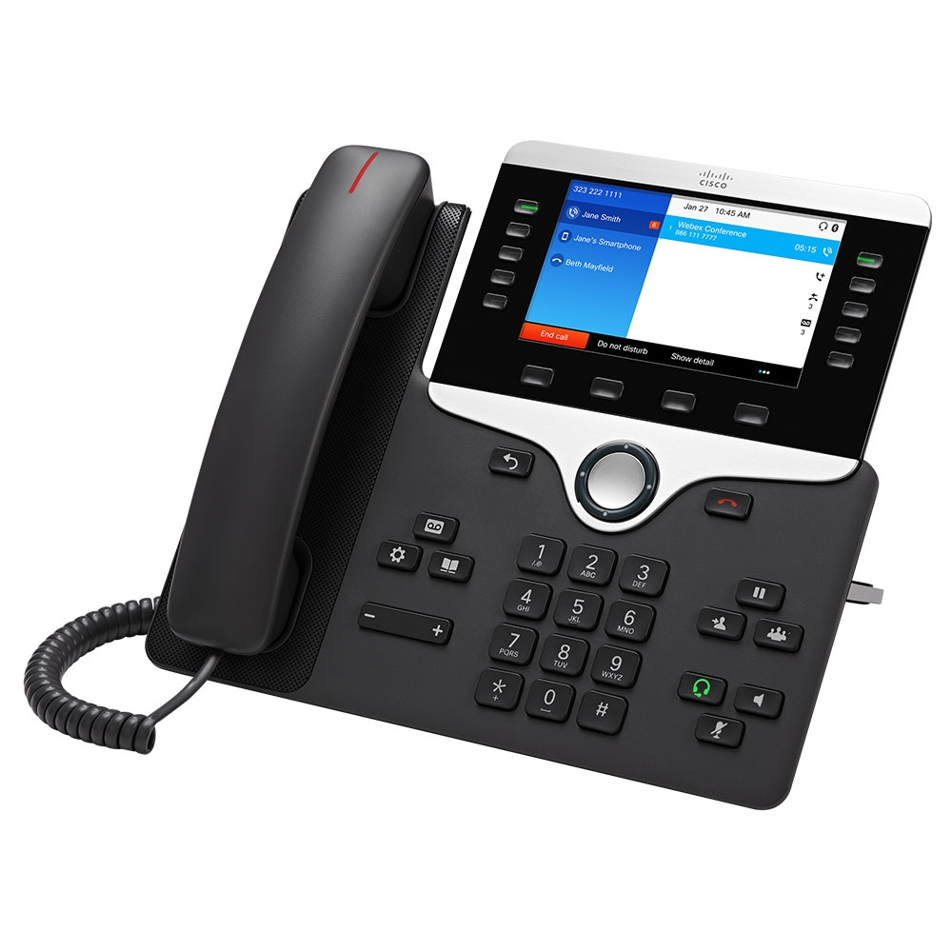
Telecommunications
Internal Phone Numbers
757-269-####
Dial last four on-site (extension)
Pager Numbers
757-584-####
Paging through Staff Search and JList
Long Distance
You must have a long distance code
Dial 9 for outside calls

Slide 11


Security
Government Facility vs. Academic Facility
If you’re not sure, then don’t do it!
We take Cyber Security very seriously
Appropriate Use Policy
Avoid unsolicited email, phishing attempts, and shady websites
Don’t download random software or games
Be very leary of flash drives, DVDs/CDs, or disks
Loss of privileges on JLab systems

Slide 12
Scientific Computing (SciComp)
RESOURCES
ifarm (Interactive Farm)
Wide area gateway nodes and infrastructure support nodes
Testing your code
farm (Batch Farm)
Batch computing for experimental physics
Requires a certificate
Tape Library
Offline storage – 2.3 Petabytes
High Performance Computing (HPC)
LQCD – Lattice quantum chromodynamics
Visit https://scicomp.jlab.org for more information

Slide 13
Physics Specific Software
Default CUE software located in /apps/bin and installable via RedHat Package Manager (RPM)
LaTeX Editors – Standard for the communication and publication of scientific documents
Compilers, programming languages, version control systems – GCC, GFortran, Perl, Python, Git, Apache Subversion (SVN) etc.
Info about ROOT Geant4 and CERNLIB
https://data.jlab.org

Slide 14
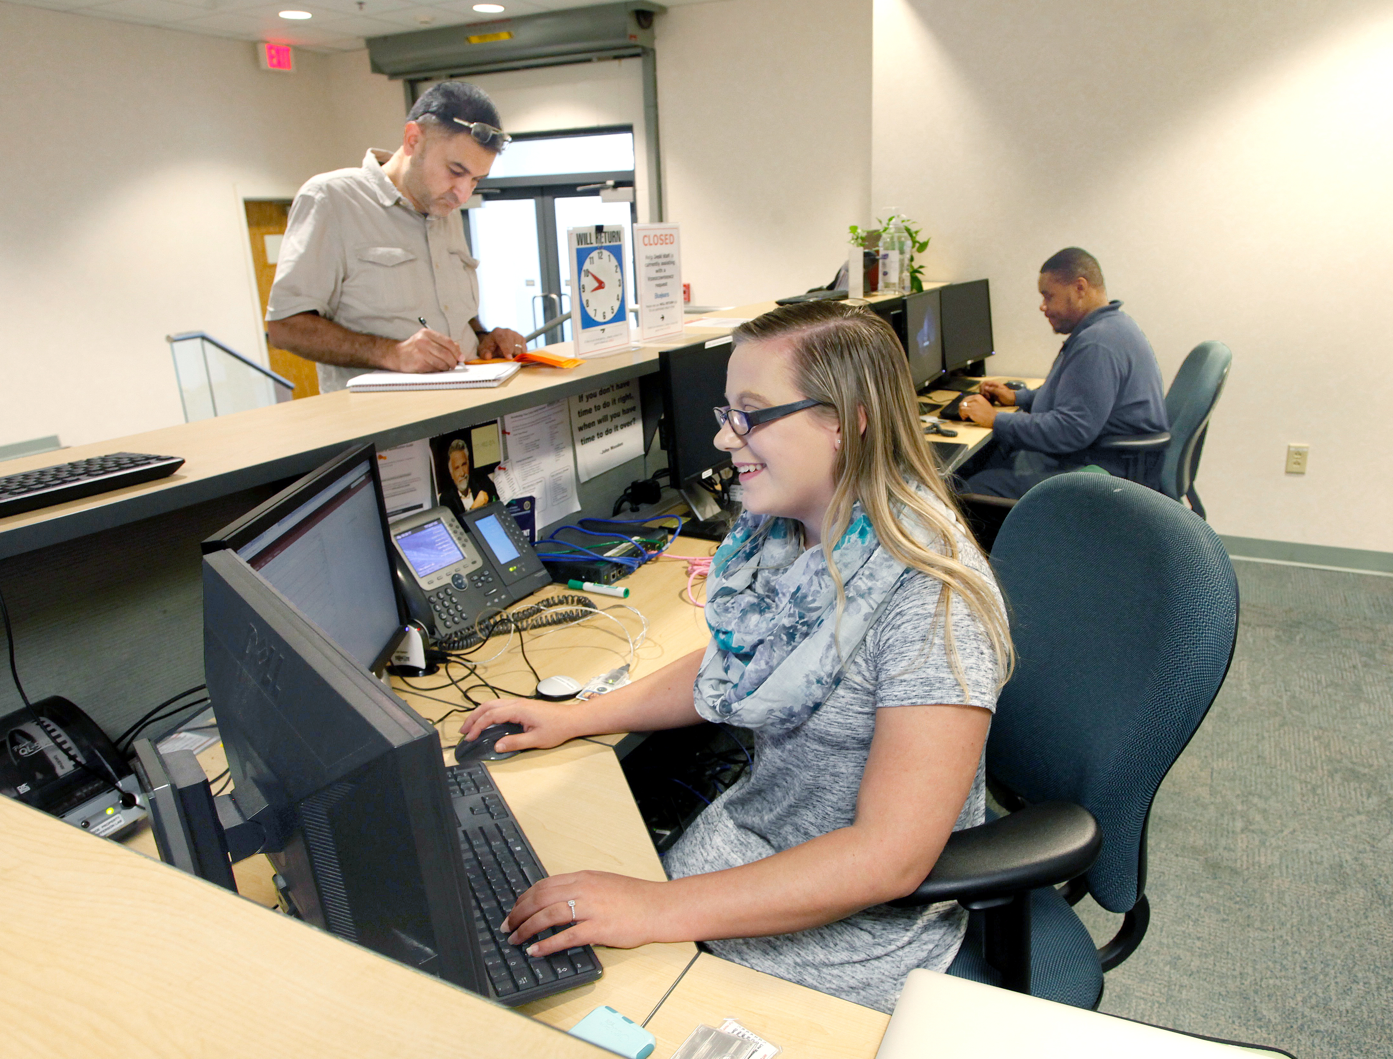
Questions?
IT Division Help Desk
CEBAF Center, F-Wing 2nd Floor
Monday – Friday, 8:00AM to 4:30PM
757-269-7155 or helpdesk@jlab.org
Topics Covered:
IT Division Groups
Computer Accounts
Email
Supported Operating Systems
File Systems Shares
Network (Wired & Wireless)
Telecommunications
Security
Scientific Computing
Physics Specific Software

Slide 15
Don’t forget to take GEN034
Annual Security Awareness Training
https://www.jlab.org/human_resources/training/webbasedtraining

